Slide 1
Milestone Presentation

Slide 2
Intro

Slide 3
TOPIC
-Representation of women in film
Since the academy awards began in 1929, only 5 women nominated for the best director category, 2 of which have won.
Film-making has long been a male dominated field.
-Bechdel test
Measure of gender depiction in films
Must pass 3 requirements in order to pass the test

Slide 4
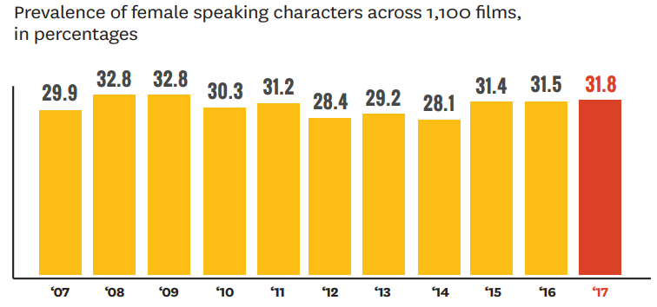

Slide 5
Why is representation of women in film important?
Fight against inequality
Can help increase self-esteem, and reduce stereotype
Constant media exposure
Opens the door wider for women to shine and be discovered
Creates powerful and relatable role models and sources of inspiration
Platform for voices to be heard
Symbolic annihilation

Slide 6
How is this a machine learning problem?
We wanted to see which factors contribute most to whether a movie passes the test or not.
Do movies made in the United states tend to have more passes or fail?
Are foreign films more likely to have better representation of women?
Is the score a movie gets correlated to the pass or fail of the test?

Slide 7
Method

Slide 8
The Data
New Structure
Determining relevant features
Deciding group cut-offs
3
Original Structure
Too many columns
2
Sourced from Dataworld
1400 movies
2010-2014
Bechdel test passes
1
Notes:
Sourced from dataworld
Original structure
Had 26 columns
New structure
Narrow down number of columns, and make categories into decision tree friendly categories

Slide 9
Movie Title
Passes Bechdel Test?
Number of Criteria Passed
Clarity of Pass
Has at least two [named] women in it
The women talk to each other
The women talk about something besides a man
Genre
Director
Main Actors
Production Company
Plot Keywords (top 10)
Year
Rating
Runtime (min)
Plot
Language
Country
Image
IMDb Popularity Score
Award Popularity
IMDb rating
IMDb votes
Nominations
Wins
IMDB Link
Passes Bechdel Test?
Clarity of Pass
Genre
Rating
Runtime (min)
Language
Country
IMDb rating
Wins
Notes:
Cut down number of values to 6 binary values that would determine information gain
(genre, rating, runtime, language, IMDb rating, wins)
And two other columns:
Pass beckdel test - the goal of the decision tree
Country (us vs non-us) - for two different decision trees
For example, values that were cut:
Movie title, plot, and keywords - cut because of irrelevant textual data
Year - would have been an interesting variable BUT a very narrow range (2010-2014) made it difficult to reduce the category into a reasonable binary (not much difference between the extremes, a year range would have been better if decade or more separation was present)

Slide 10
Notes:
The remaining categories were split into binaries we felt were most appropriate
E.g. There were a lot of genres and many movies fell into more than one.
Therefore, we separated them into dramatised and lifelike, and prioritied the appearance of dramatised units when deciding genre

Slide 11
Algorithm - Decision Tree
Implementation
Implemented in Excel
Two decision trees
Calculate information gain, use most prominent feature to continue
Plotting the tree
Performance Evaluation
Amount of information gain per variable
An effective decision tree would
High % stopping point
Check if branches make intuitive sense
Notes:
Used Excel
Two decision trees: One for US, another for non-US countries, because we wanted to compare them
As in class, we can calculate the highest information gain and continue along the branches until a decision is reached
Decision trees provide a very visual result, so we used a tool called Smartdraw to plot the tree
Algorythm evaluation
High information gain = indicates that variables produce useful information
Having to use a lower stopping point indicates less certainty in decisions
Branches can be checked for errors

Slide 12
Results and Interpretations

Slide 13
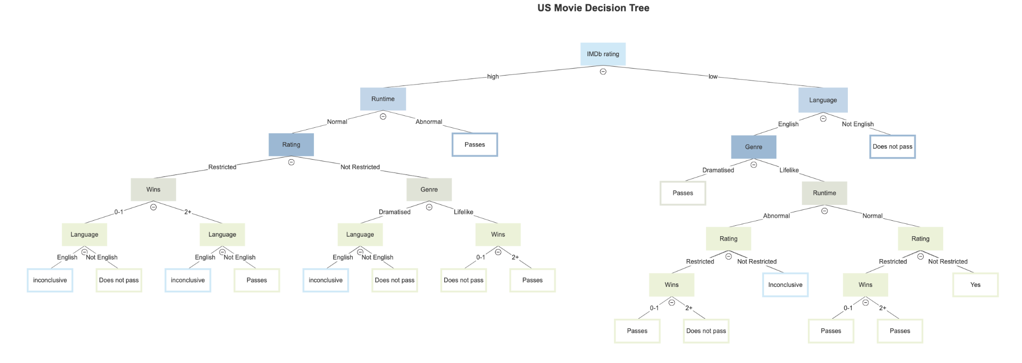
US MOVIE DECISION TREE
2. EXTRA RESOURCES
For Business Plans, Marketing Plans, Project Proposals, Lessons, etc

Slide 14
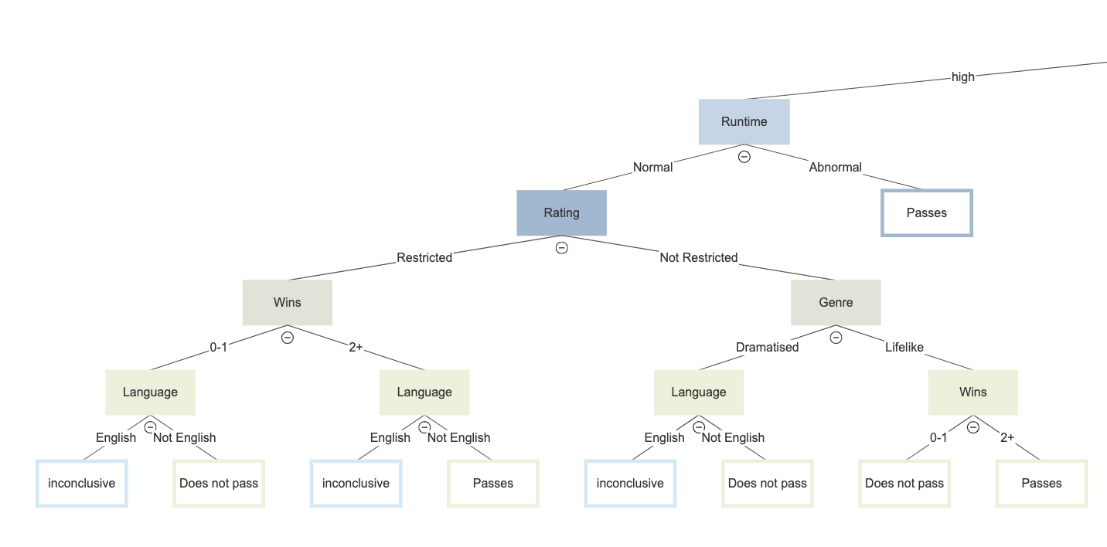
US MOVIE DECISION TREE - high IMDb
2. EXTRA RESOURCES
HIGH IMDb RATINGS
4374/7398 films pass - 59.1%
All abnormal runtime movies fall into pass category
‘Not English’ varies - no significant pattern
English had a large majority - 1225 films in this category
English always resulted in inconclusive
More popular films pass the test while less popular films do not
For Business Plans, Marketing Plans, Project Proposals, Lessons, etc

Slide 15
US MOVIE DECISION TREE
2. EXTRA RESOURCES
For Business Plans, Marketing Plans, Project Proposals, Lessons, etc

Slide 16
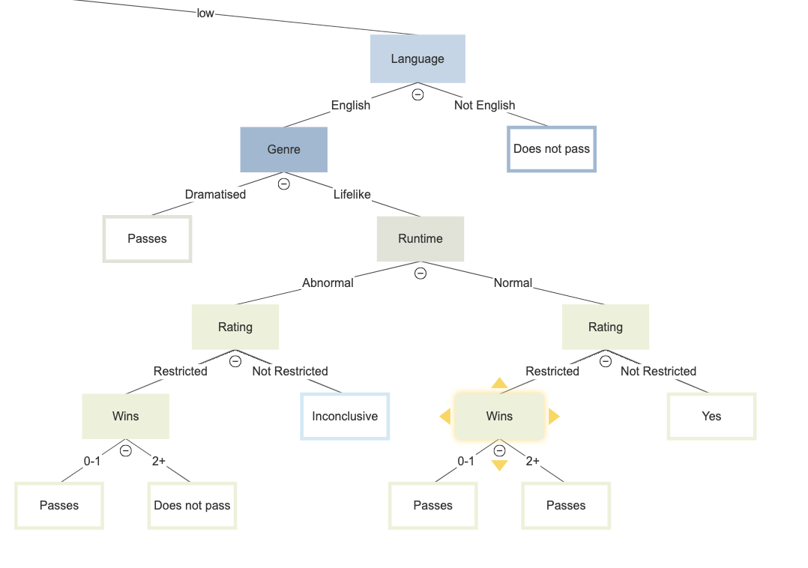
US MOVIE DECISION TREE - low IMDb
2. EXTRA RESOURCES
LOW IMDb RATINGS
434/631 films pass - 68.8%
All ‘Not English’ movies fail the test
Dramatised movies all pass the test
Normal Runtime films always pass the test
Regardless of number of wins or rating
Female character and dialogue contribute to runtime/regular runtime entails more time for female characters to speak
Opposite of what we expected - ‘Wins’ category
Less popular films pass the test while more popular films do not
For Business Plans, Marketing Plans, Project Proposals, Lessons, etc

Slide 17
Challenges and Limitations

Slide 18
Finding conclusive results
Confounding variables (ex. plot, runtime, genre, dialogue)
Genre categorisation
Dramatisation vs lifelike separation
Plan to evaluate each leaf node as different areas of film

Slide 19
Presentation End

